Slide 1
Data Structure (CSE 2101)
Instructor: Hasnain Heickal
Department of CSE, University of Dhaka

Slide 2
Binary Search Tree
Instructor: Hasnain Heickal
Department of CSE, University of Dhaka

Slide 3
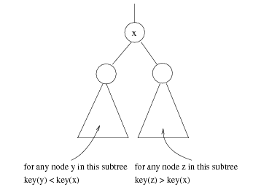
Binary Search Trees
Stores keys in the nodes in a way so that searching, insertion and deletion can be done efficiently.
Binary search tree property
  For every node X, all the keys in its left subtree are smaller than the key value in X, and all the keys in its right subtree are larger than the key value in X

Slide 4

Binary Search Trees
A binary search tree
Not a binary search tree

Slide 5

Binary Search Trees
Two binary search trees representing
the same set:
Average depth of a node is O(log N); maximum depth of a node is O(N)

Slide 6
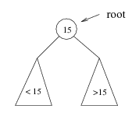
Searching BST
If we are searching for 15, then we are done.
If we are searching for a key < 15, then we should search in the left subtree.
If we are searching for a key > 15, then we should search in the right subtree.

Slide 7
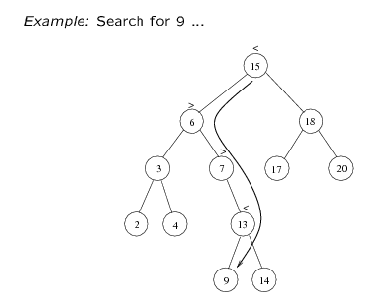
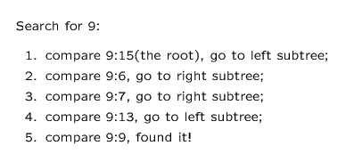

Slide 8
Searching (Find)
Find X: return a pointer to the node that has key X, or NULL if there is no such node
Time complexity
  O(height of the tree)
int search(BST root, int searchValue)
{
if (root.value equals searchValue)
return root;
else if (root.value > searchValue)
return search(root.left, searchValue)
else if (root.value < searchValue)
return search(root.right, searchValue)
}

Slide 9
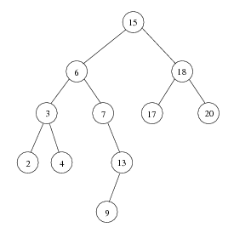
Inorder traversal of BST
Print out all the keys in sorted order
Inorder: 2, 3, 4, 6, 7, 9, 13, 15, 17, 18, 20

Slide 10
findMin/ findMax
Return the node containing the smallest element in the tree
Start at the root and go left as long as there is a left child. The stopping point is the smallest element
Similarly for findMax
Time complexity = O(height of the tree)

Slide 11
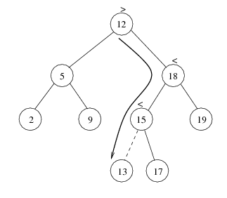
insert
Proceed down the tree as you would with a find
If X is found, do nothing (or update something)
Otherwise, insert X at the last spot on the path traversed
Time complexity = O(height of the tree)

Slide 12
delete
When we delete a node, we need to consider how we take care of the children of the deleted node.
  This has to be done such that the property of the search tree is maintained.

Slide 13
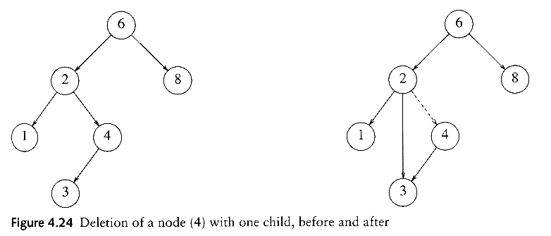
delete
Three cases:
(1) the node is a leaf
  Delete it immediately
(2) the node has one child
  Adjust a pointer from the parent to bypass that node

Slide 14
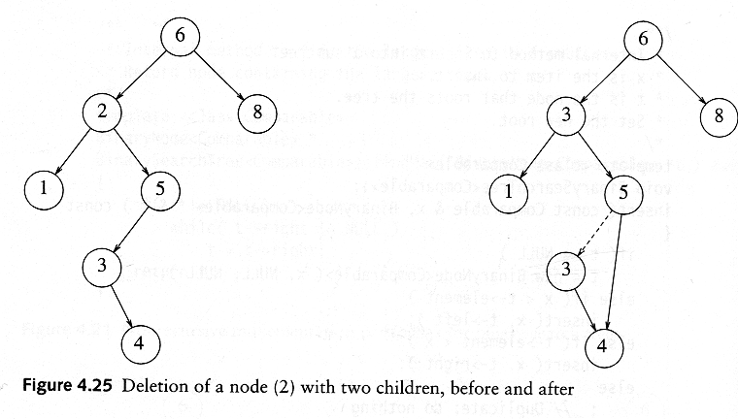
delete
(3) the node has 2 children
  replace the key of that node with the minimum element at the right subtree
  delete the minimum element
    Has either no child or only right child because if it has a left child, that left child would be smaller and would have been chosen. So invoke case 1 or 2.
Time complexity = O(height of the tree)

Slide 15
Comparison
Array (unsorted/sorted)
  Insert?
  Delete?
  Search?
Linked List (unsorted/sorted)
  Insert?
  Delete?
  Search
What about BST?
http://bigocheatsheet.com/

Slide 16
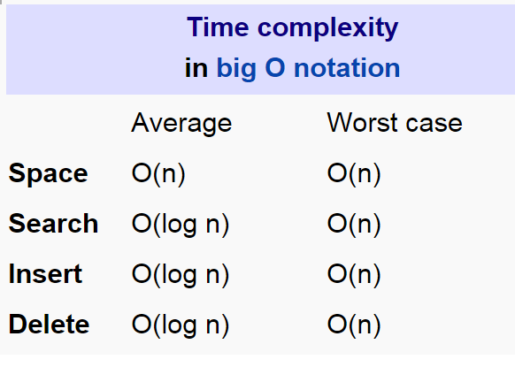
Time Complexity

Slide 17
Application of BST
Binary Search Tree
  Used in many search applications where data is constantly entering/leaving, such as the map and set objects in many languages' libraries.

Slide 18
Study Materials
CLRS: Chapter 12: Binary Search Trees
Adam Drozedek : Chapter 6

